Slide 1
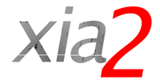
DIALS and Eigers
High Data Rate MX Meeting
Brookhaven National Lab, Thurs. May 26, 2016

Slide 2
Acknowledgements
Support for development of xia2 / DIALS:
Diamond Light Source
NIH / R01-GM117126
EU (Biostruct-X)
CCP4
xia2:
Graeme Winter, Richard Gildea, Markus Gerstel
DIALS:
UK: Gwyndaf Evans, David Waterman, James Parkhurst, Richard Gildea, Luis Fuentes Montero, Markus Gerstel, Graeme Winter
US: Nick Sauter, Aaron Brewster, Iris Young, Tara Michels Clark

Slide 3
Overview
DIALS philosophy
Move from CCD to pixel array detector, Pilatus to Eiger
Robustness
Performance

Slide 4
DIALS Philosophy
Build on the work of others as a starting point i.e. papers on XDS, Mosflm, d*TREK, LURE workshops, astronomy, ...
Make it right, then make it fast
Emphasise mathematical robustness
Emphasise toolkit approach over monolith

Slide 5
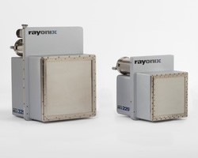
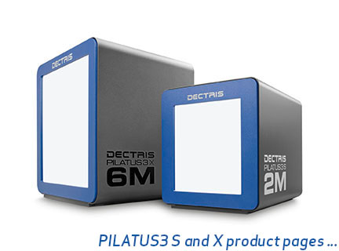
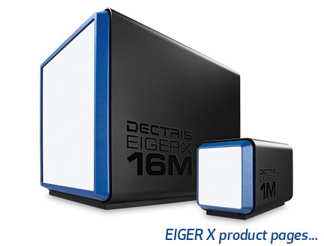
Transitions
CCD PAD: Pilatus PAD:Eiger
New Algorithms
New Infrastructure

Slide 6
Weaker data
CCD data collection balanced signal to readout noise, dark current, … therefore need strong data
PAD detection process means no compromise necessary, therefore spread dose / damage around reciprocal space more uniformly
Example here thaumatin recorded on I03, Pilatus2 6M with 0.05% transmission
Background modelling / treatment a particular challenge - most pixels are 0

Slide 7
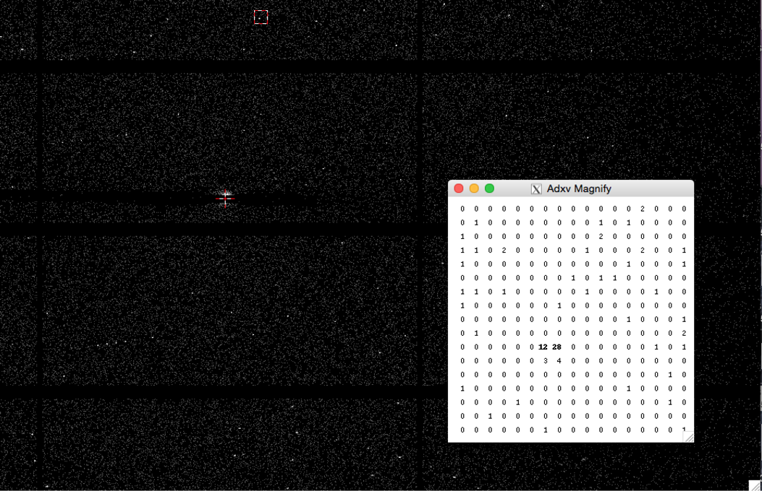
Strong low resolution spot

Slide 8
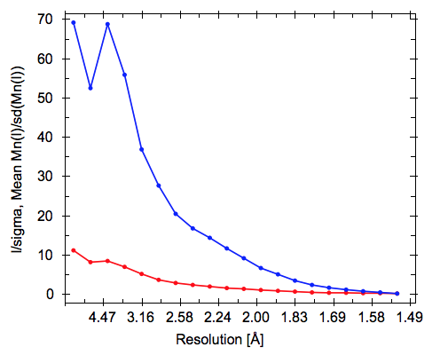
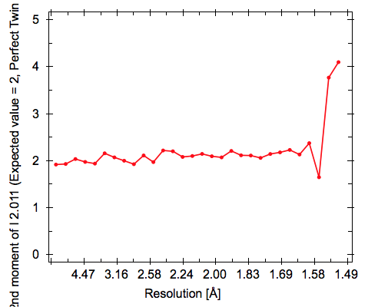
Treatment
I/sig(I) well behaved, tend to 0 at high resolution
E⁴ (measure of exponential-ness of mean intensity for each HKL) well behaved to high resolution
R_{merge} in outer shell crazy, but data broadly good, R_{pim} overall < 1%

Slide 9
Performance
CCD detector - processing during collection realistic
Pilatus @ 10 Hz - data set around 3 minutes, fast processing OK (see DIAMOND talk later) xia2 already “too slow” for interactive feedback
Pilatus6M @ 10 Hz - may as well wait for data to be finished before processing
Pilatus6M @ 100 Hz - data set in 18s - time to give up on processing in real time, fast processing now too slow for real-time
Eiger9M @ 200 Hz - real-time effectively impossible

Slide 10
processor : 19
vendor_id : GenuineIntel
cpu family : 6
model : 63
model name : Intel(R) Xeon(R) CPU E5-2650 v3 @ 2.30GHz
stepping : 2
microcode : 54
cpu MHz : 1200.000
cache size : 25600 KB
physical id : 1
siblings : 10
core id : 12
cpu cores : 10
apicid : 56
initial apicid : 56
fpu : yes
fpu_exception : yes
cpuid level : 15
wp : yes
flags : fpu apic sep mtrr pge tla mca cmov wtf pat lol pse36 clflush dts acpi mmx fxsr sse sse2 ss ht tm pbe syscall ....
bogomips : 4599.37
clflush size : 64
cache_alignment : 64
address sizes : 46 bits physical, 48 bits virtual
power management:

Slide 11
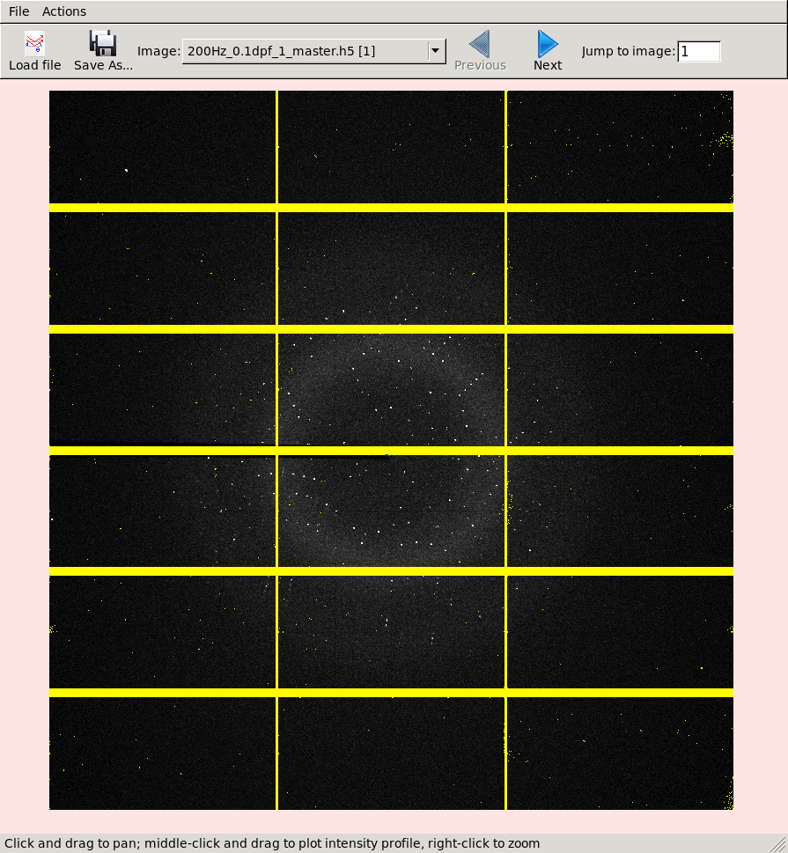
Example set
Eiger 9M @ Soleil
1800 @ 0.1 degrees / 200 Hz (9s)
Transthyretin
Excellent example set because we have the same data in CBF and HDF5 format
High resolution limit 1.51 4.10 1.51
Low resolution limit 43.28 43.30 1.54
Completeness 100.0 100.0 100.0
Multiplicity 6.5 6.7 6.6
I/sigma 14.9 62.7 1.3
Rmerge(I) 0.047 0.019 1.549
Rmeas(I) 0.052 0.021 1.680
Rpim(I) 0.020 0.008 0.645
CC half 0.999 0.999 0.510
Total observations 249898 13959 12541
Total unique 38307 2081 1900
Assuming spacegroup: P 21 21 21
Unit cell:
43.281 64.448 85.398
90.000 90.000 90.000

Slide 12
Timing
 | Lustre cbf | /hdf5 | GPFS cbf | /hdf5 | RamDisk cbf | hdf5 | RamDisk cbf xds | hdf5 xds
Spot Finding | 74.5 | 82.6 | 70.4 | 95.8 | 67.9 | 79.8 | 40.2 | 204.8
Integration | 245.3 | 240.3 | 262.5 | 255.4 | 242.0 | 235.3 | 96.6 | 234.7
xia2 | 11m50s | 10m51s | 12m43s | 10m51s | 10m02s | 10m12s | 7m09s | 15m04s

Slide 13
Spot finding efficiency (rotation data)
1800 frame rotation set
Data in ramdisk
2..20 cores on 20 core machine
Ran on 12 machines independently 10 times each => 120 observations
Ran same with CBF & HDF5; record wall clock time

Slide 14
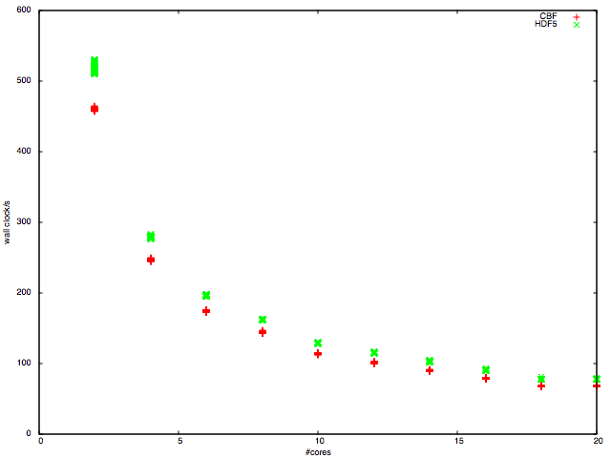
Wall clock time CBF vs. HDF5

Slide 15
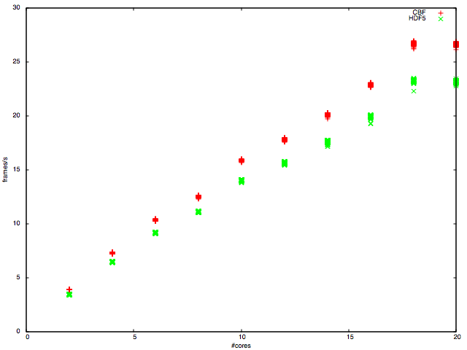
Rate CBF vs. HDF5

Slide 16
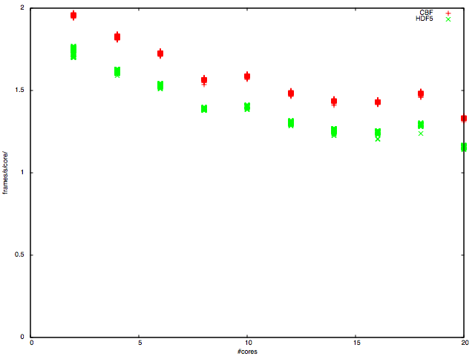
Efficiency / rate CBF vs. HDF5

Slide 17
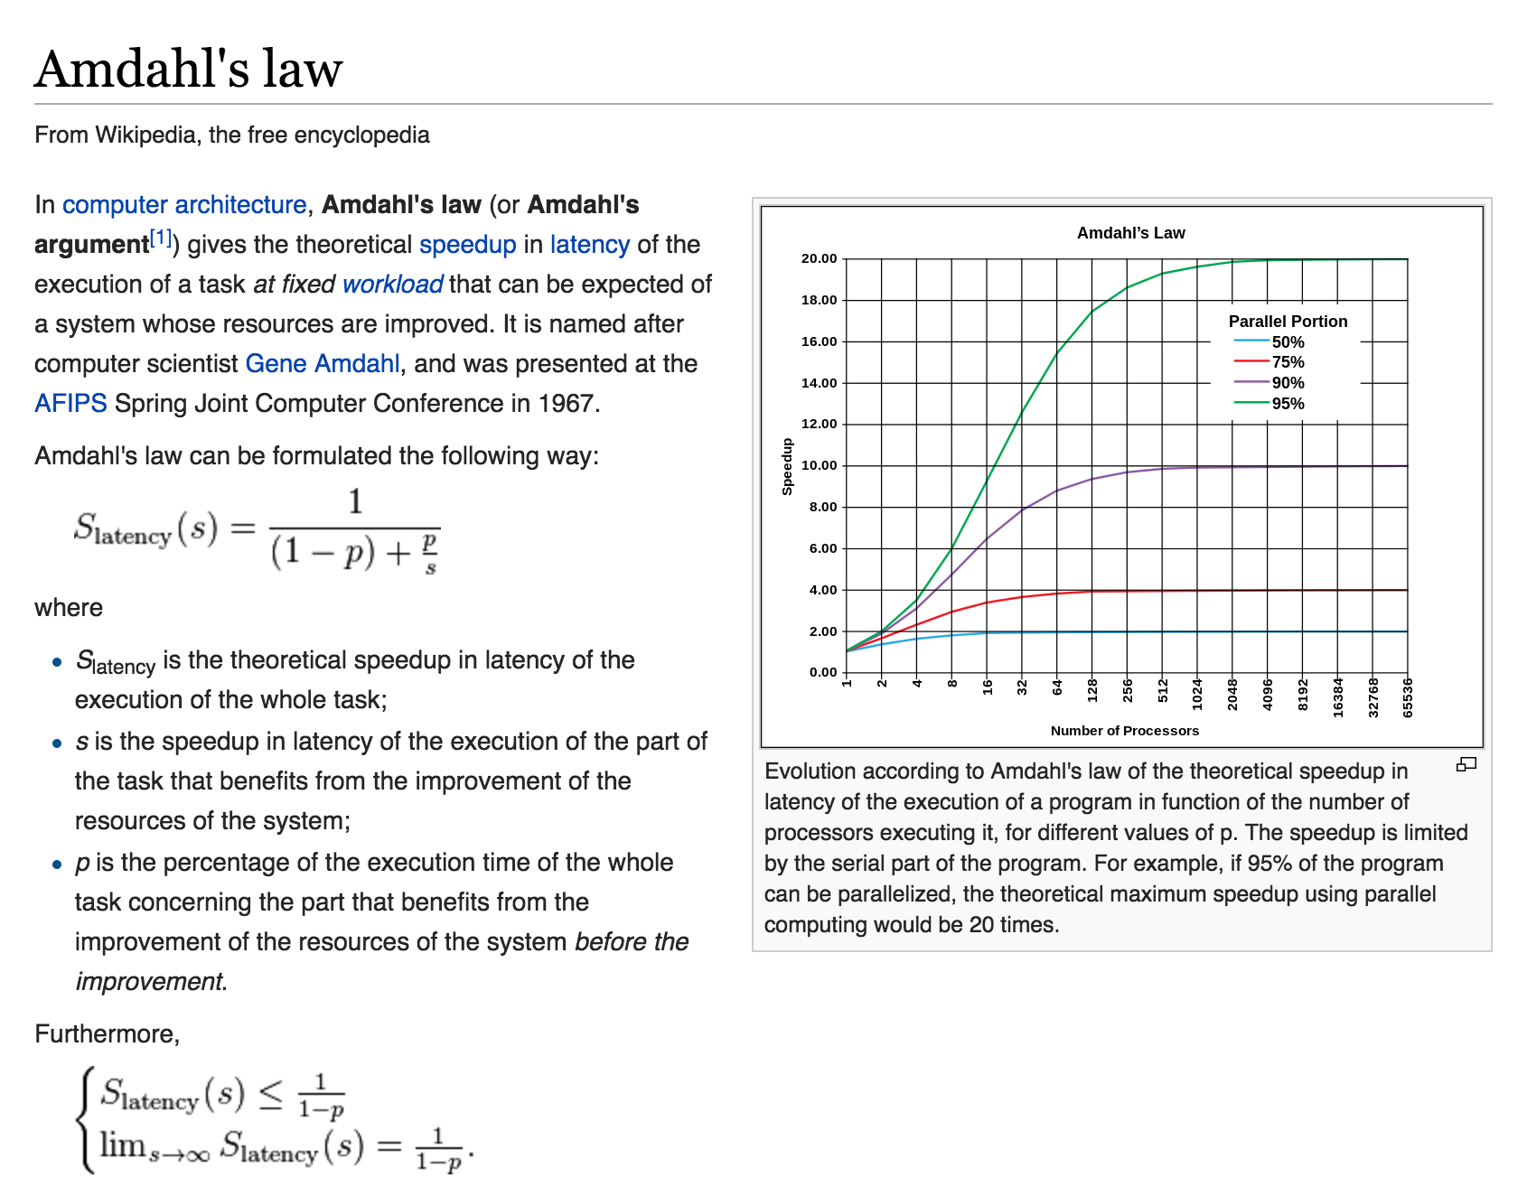

Slide 18
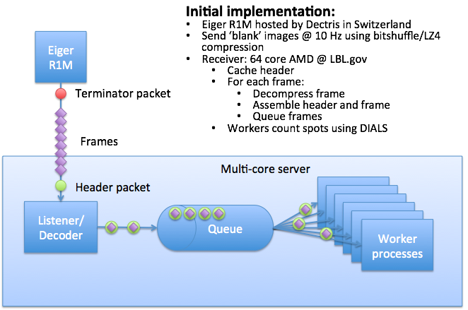
Eiger to Dials streaming interface

Slide 19
Architecture
At DLS use principally 2-socket Intel (Xeon) machines - good balance of CPU / memory bandwidth / network / ....
Other architectures (i.e. AMD) may give you different mileage

Slide 20
Conclusions
DIALS works natively with Eiger HDF5 data & gives good results
DIALS works well for weak data => low dose high multiplicity collection a reality
DIALS spot finding scales well with #cores
DIALS timing is very reproducible
Spot finding on HDF5 data significantly slower than CBF however not substantially so (10%)
Spot finding using DIALS on one 20-core machine gives rate of 25 9M images/second - roughly order of magnitude less than we need; so we need 10 machines
DIALS should be able to go a bit faster (factor 2 not 10) => for CBF files XDS substantially quicker at spot finding / integration

Slide 21
EOF

Slide 22
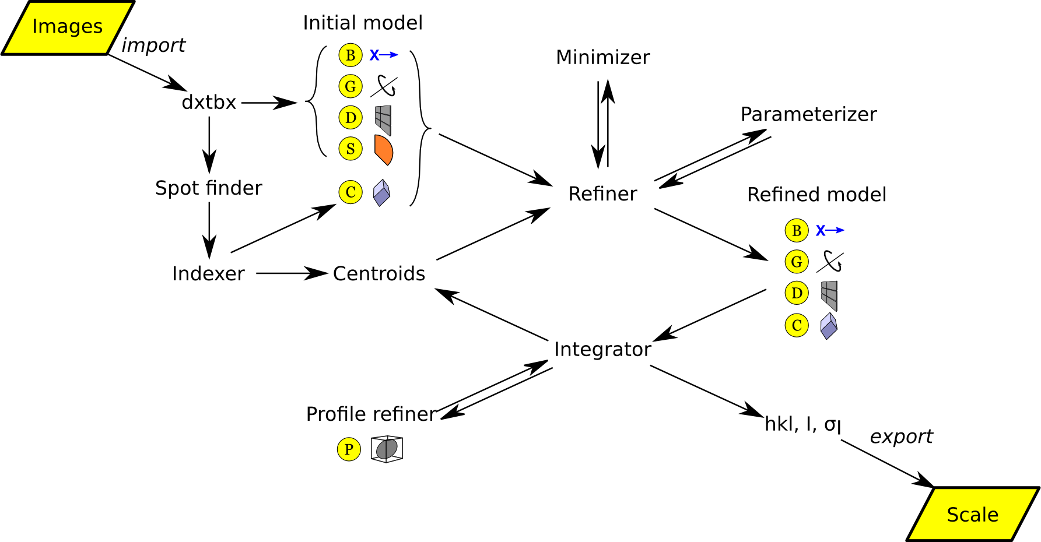
DIALS philosophy

Slide 23
Transitions
For DIALS / xia2:
Detector behaviour - identical mathematical problem, well supported
Fine slicing works fine with 3D profile fitting
One file per image, now one file per scan - easily handled via dxtbx
Metadata stored in binary arrays in HDF5 - easily handled via dxtbx
HDF5 external references just work

Slide 24
Robustness
Only need to address format for the data - everything else (should) just work
Given frame rate, principle risk could be weaker data
Some issues identified with parallelism
Variants on hdf5 format cause challenges

